Slide 1
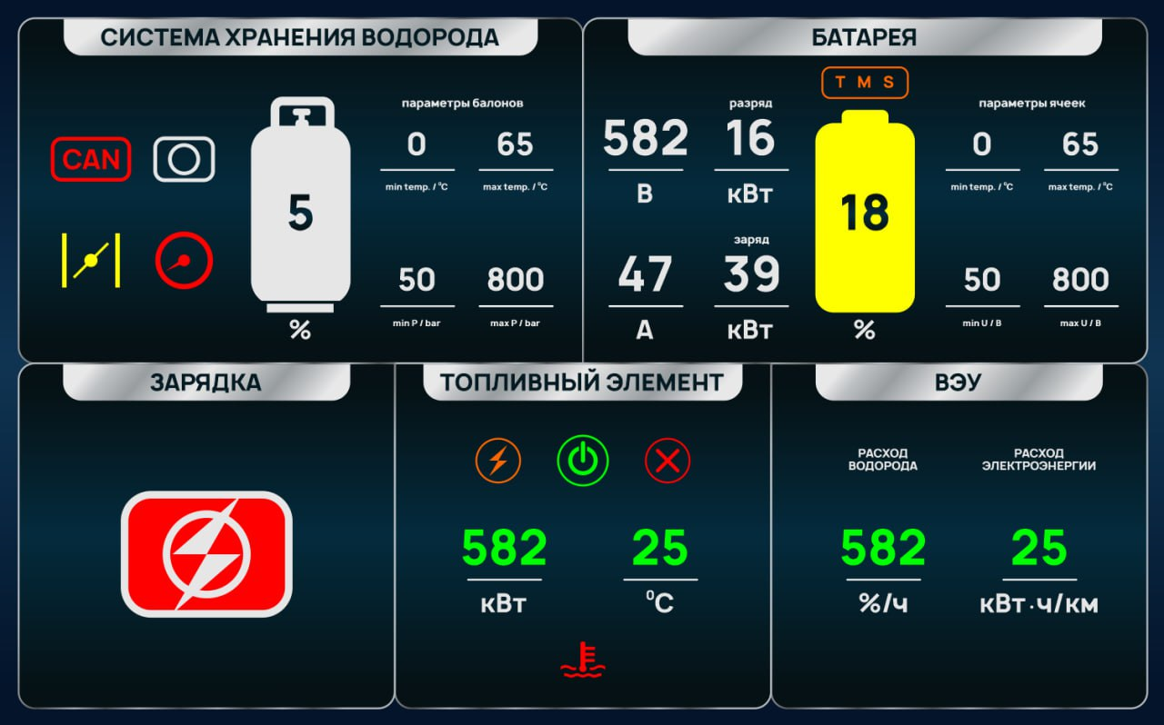
PCUMsg1,
hvVoltage
PCUMsg2,
tmsState
GasTankData,
minTankTemp
GasTankData,
maxTankTemp
PCUMsg2,
hvVoltage* (hvCurrent>0)
PCUMsg2,
minBattTemp
PCUMsg2,
maxBattTemp
PCUMsg1,
SOC
GasTankData,
tankFilling
PCUMsg1,
hvCurrent
GasTankData,
valveState = 1
GasTankData,
minTankPrs
GasTankData,
maxTankPrs
PCUMsg2,
hvVoltage* (abs(hvCurrent<0))
PCUMsg2,
minCellTemp
PCUMsg2,
maxCellTemp
PCUMsg3,
fuelCellState == 1ИЛИ2
PCUMsg3,
fuelCellOutputPower
PCUMsg3,
fuelCellTemp
PCUMsg3,
hydrogenRate
PCUMsg3,
energyRate

